Slide 1

ADAM I/O Modules
ADAM4K/5K/6K with LabView
Name
Position/BU
Date

Slide 2

Ethernet Connection-ADAM-5kTCP/6K
OPC
Modbus TCP Protocal

Slide 3
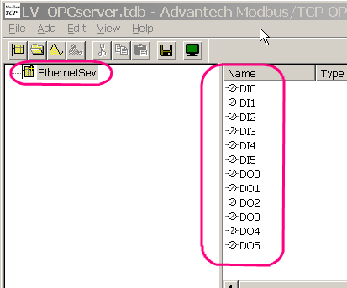
OPC connection (1)
Install Advantech Modbus TPC OPC server
In OPC server Create Tags for control/monitor

Slide 4
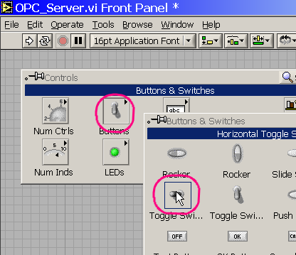
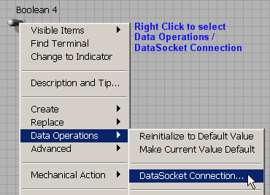
OPC connection (2)
In LabView Assign a Controller in Front Panel with OPC Tag
Add a Switch Controller

Slide 5
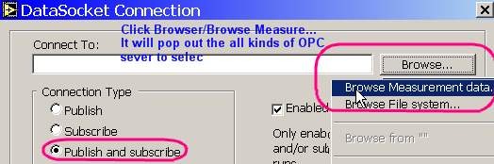

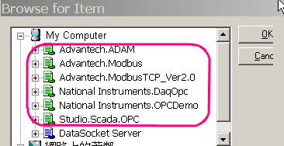
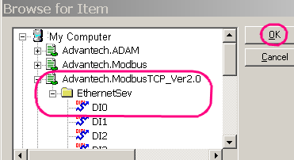
OPC connection (3)
From Browse, it will show all the OPC installed in the host PC. Select desired OPC and select corresponding I/O tag to assign for the controller

Slide 6
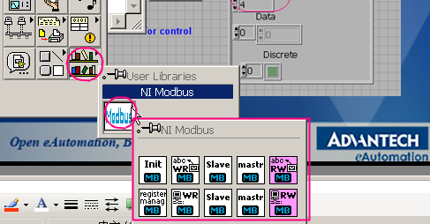
Modbus Driver in LabView (1)
NI has provide Modbus VI under LabVIEW 7.1
Please download Modbus.msi from NI Web
  http://sine.ni.com/apps/we/niepd_web_display.display_epd4?p_guid=F1582737BACF5CA8E0340003BA7CCD71&p_node=DZ52363&p_source=External

Slide 7
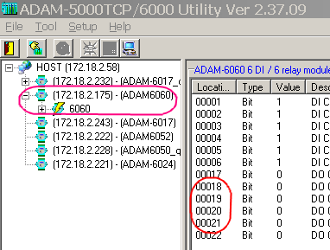
Modbus Driver in LabView (2)
Using ADAM 5KTCP/6K Utility to configure:
  ADAM module IP address
  Modbus address

Slide 8
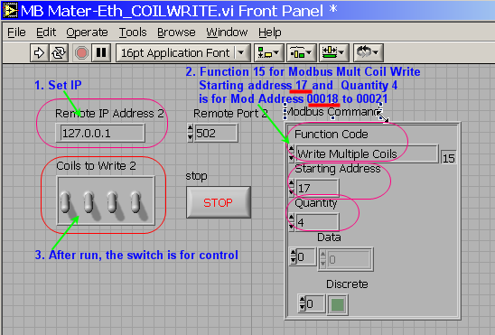
Modbus Driver in LabView (3)
Examples show how to do the DO from Modbus TCP protocal
Front Panel

Slide 9
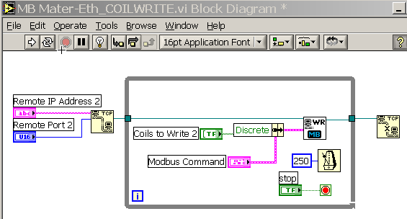
Modbus Driver in LabView (4)
Block Diagram

